Slide 1
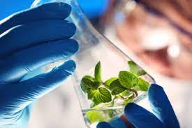
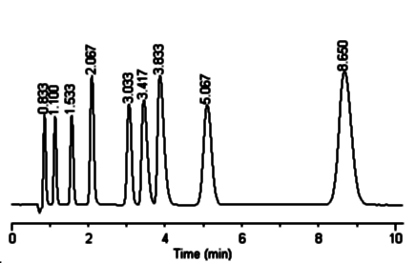
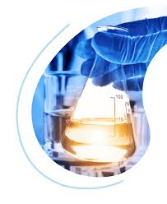
Natural Products for Medicinal Chemistry
(NPMC Lab)
Prof. Federica Pellati, Associate Professor, P.I.
Dr. Virginia Brighenti, research collaborator
Dr. Laura Bertarini, PhD student
Dr. Matilde Marani, postgraduate collaborator

Slide 2
Main research topics
Identification of natural compounds as new hit/lead for drug discovery by applying an integrated multi-disciplinary approach. A peculiar interest is devoted to proliferative diseases (cancer) and CNS diseases (neuropathic pain, epilepsy etc.)
Development of new methods for targeted and untargeted analysis of bioactive natural compounds
Development of new methods for targeted and untargeted metabolomics of compounds in biological fluids (bioanalysis)

Slide 3
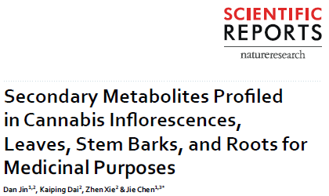
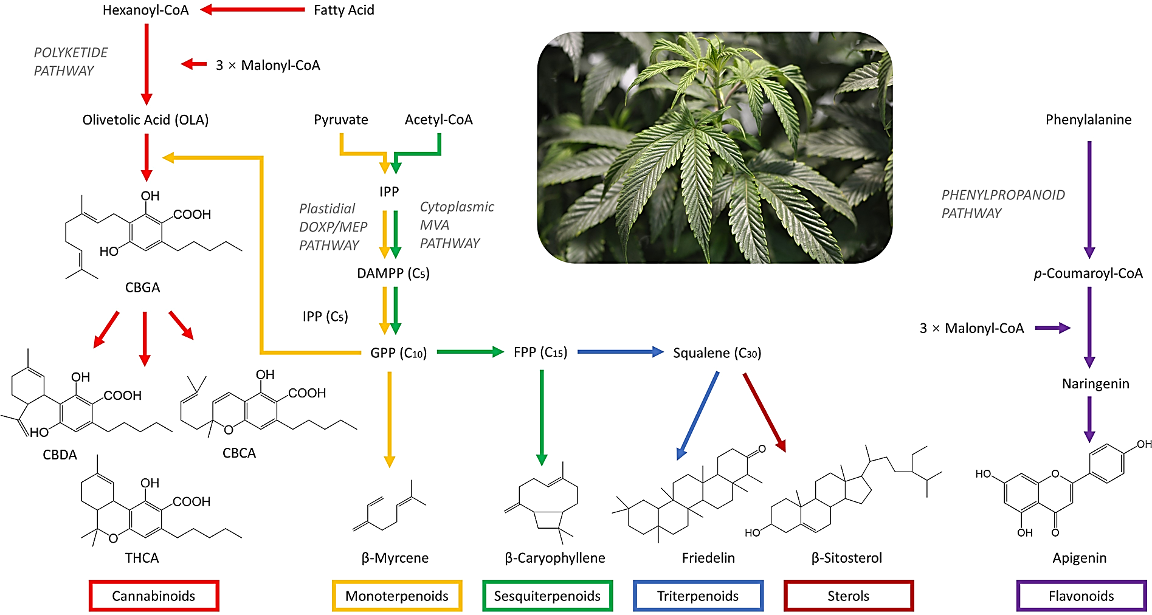
CANNABIS SATIVA L.

Slide 4
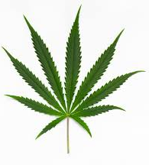


Cannabis sativa L. and its role in medicinal chemistry
Extraction and analysis
In vitro and in vivo biological assays
CANNABINOIDS
FLAVONOIDS
TERPENES
POLICOSANOLS

Slide 5
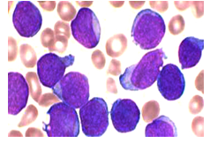
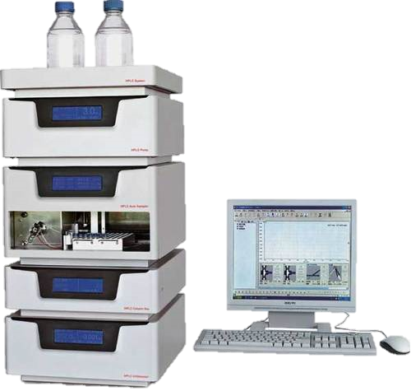
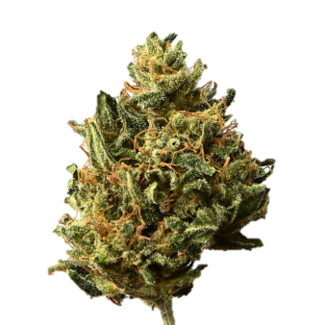
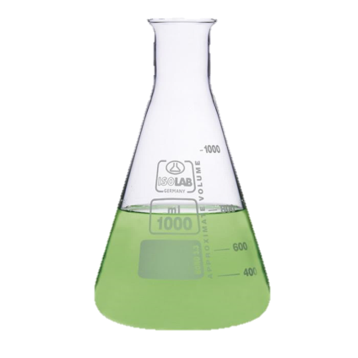
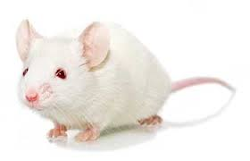
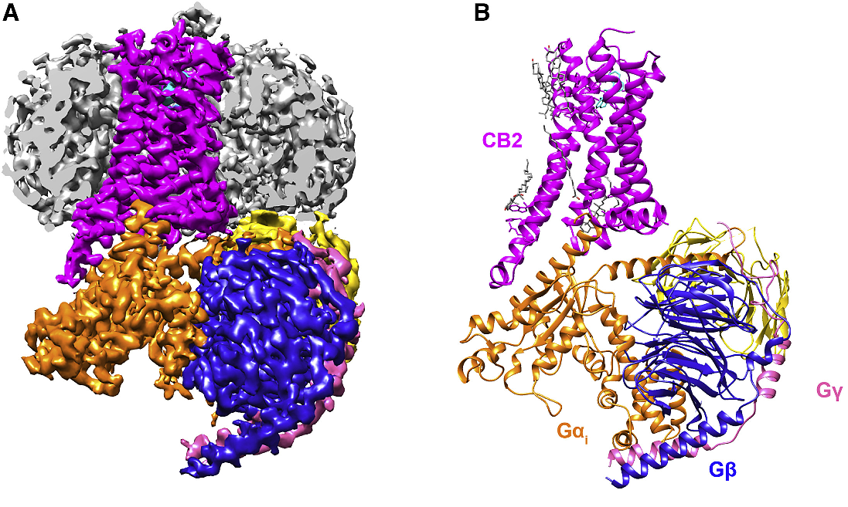
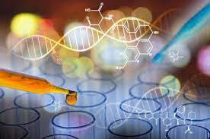
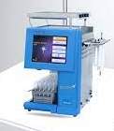
Workflow of the study
Preparation of the raw extracts
Chemical characterization
In vitro/in vivo biological assays
In silico study
Identification of the mechanism/s of action
Purification and bioassays

Slide 6

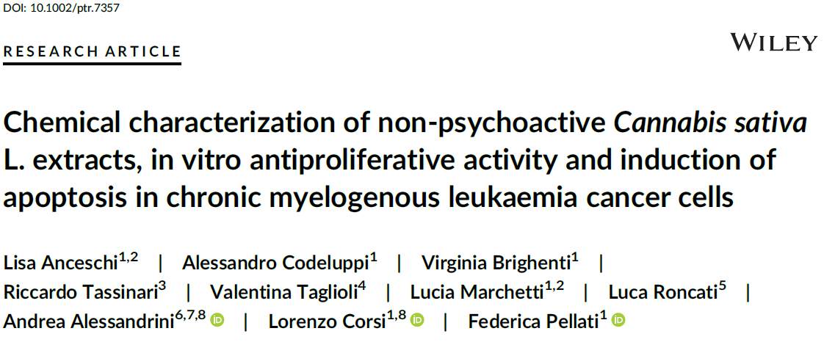
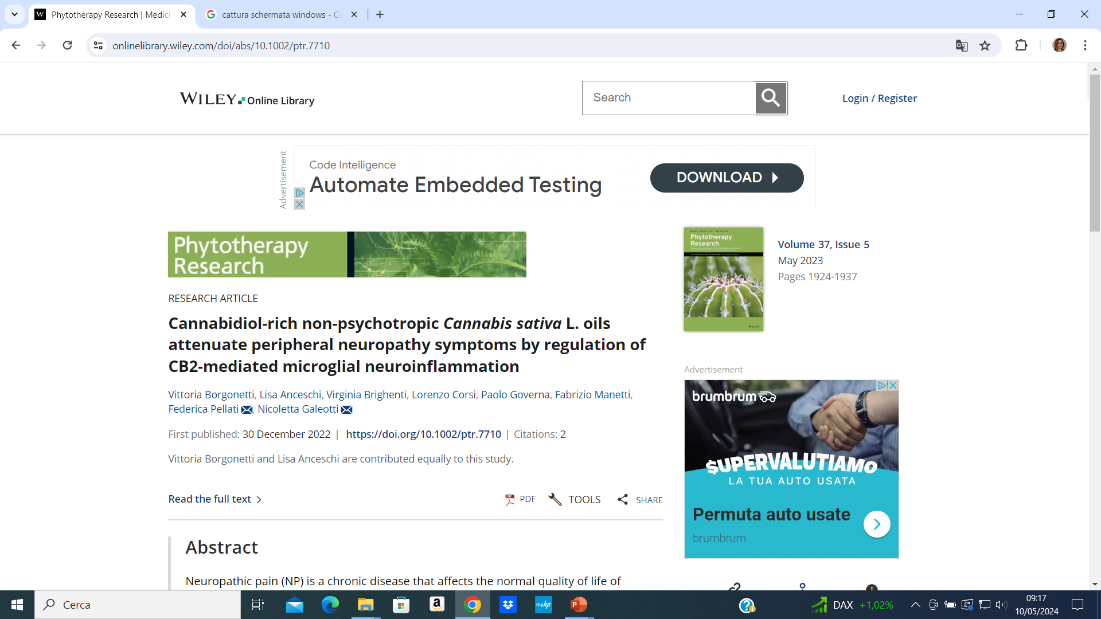
ElSohly Award 2022, American Chemical Society

Slide 7
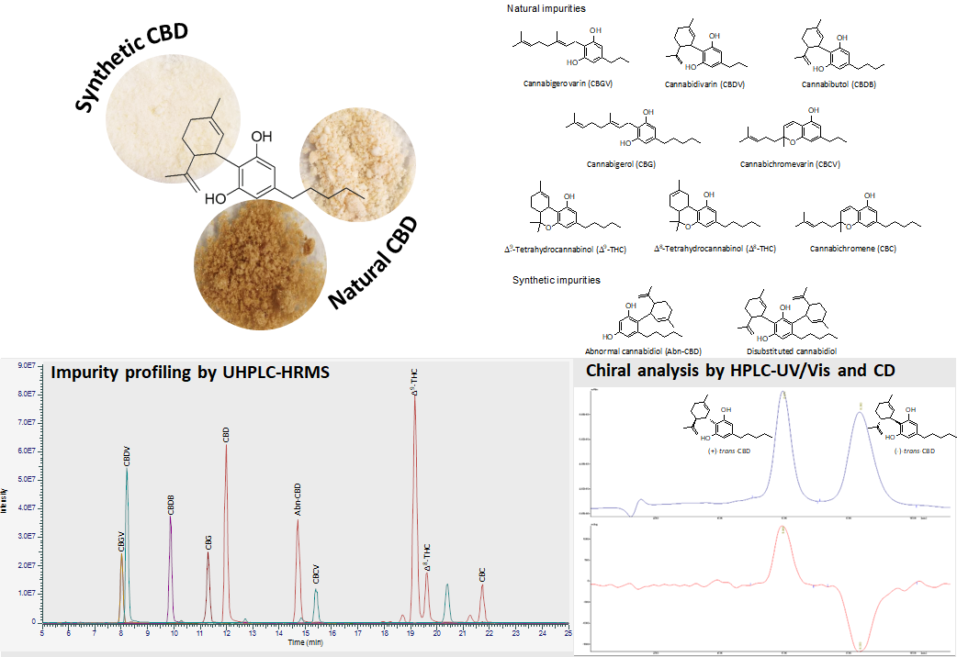
Matilde’s thesis work (December 2023)

Slide 8
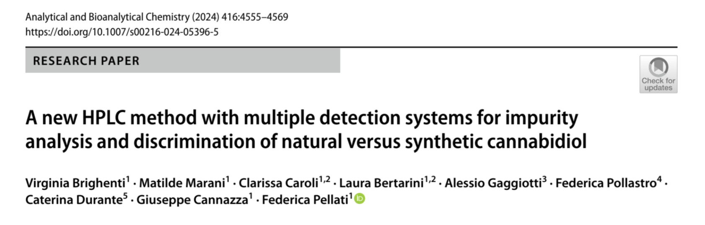

Slide 9

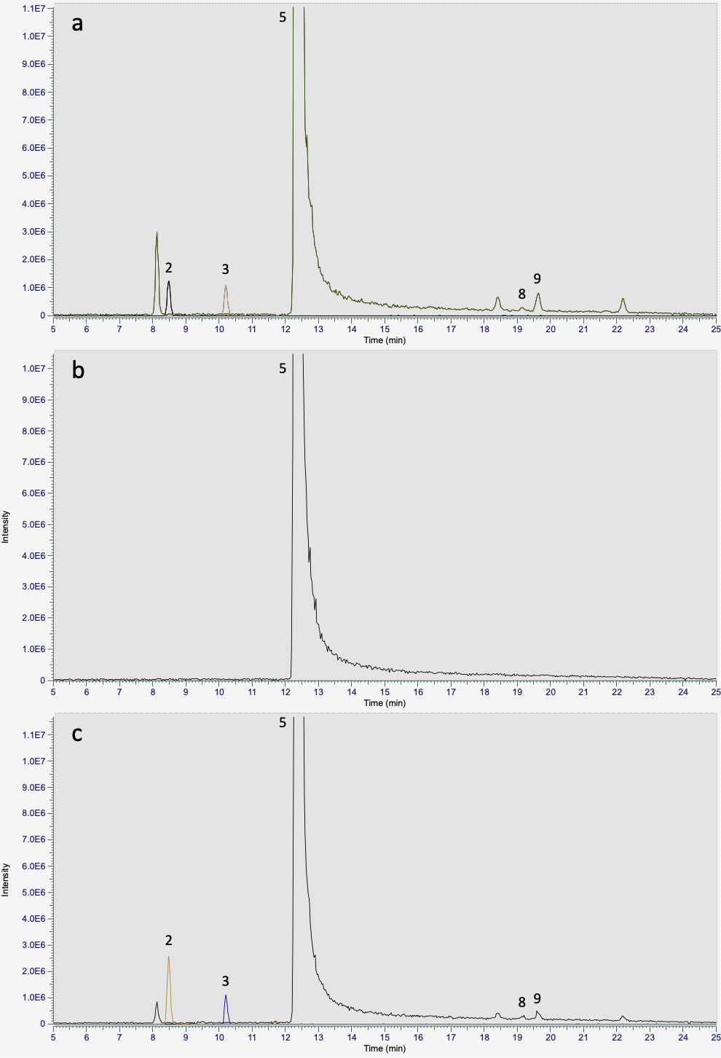
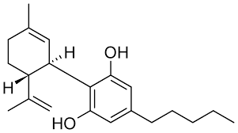
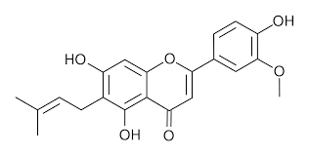

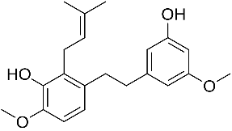
On-going PRIN-PNNR project
Deep characterization cannabinoids, polyphenols and lipophilic compounds in hemp waste material (leaves) belonging to different hemp chemotypes by means of HPLC and GC techniques
hemp leaves and other waste materials
GC-MS
GC-FID
HPLC-HRMS
HPLC-UV/Vis

Slide 10
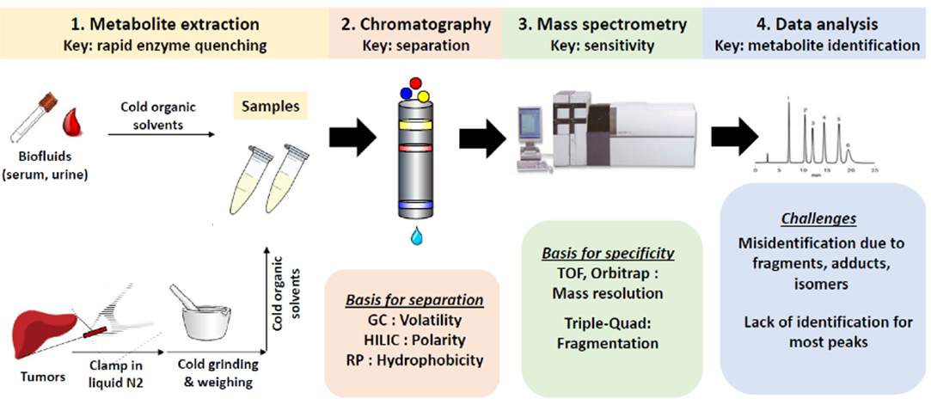
On-going PNNR project
Untargeted metabolomics on NASH patients to identify new biomarkers of the disease
Notes:
NASH steatoepatite non alcolica.

Slide 11
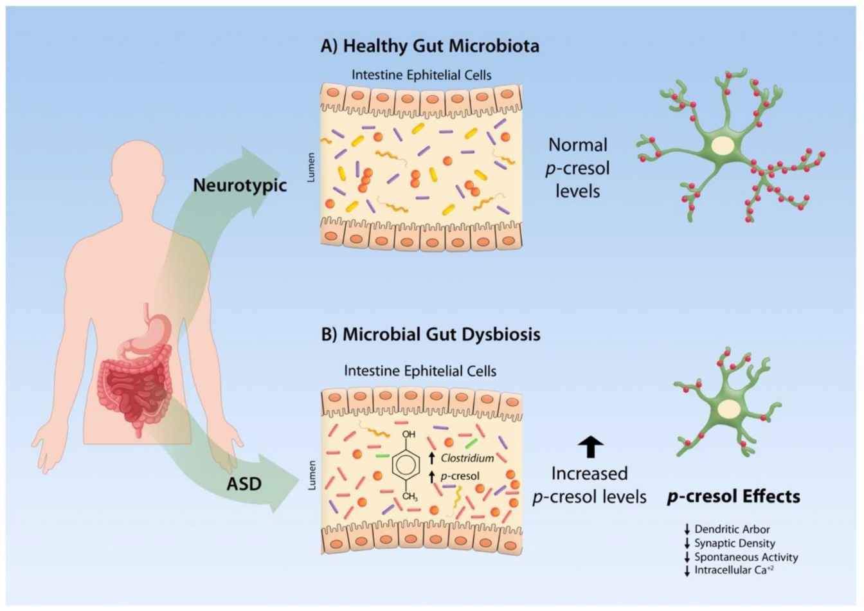
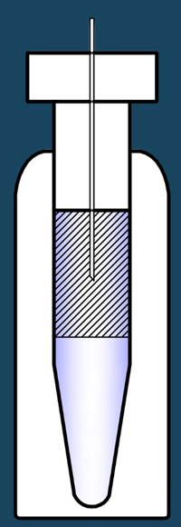
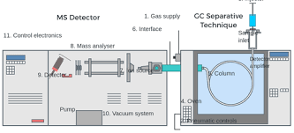
On-going project on p-cresol levels in brain tissues
Development of a new GC-MS method for the analysis of p-cresol in the CNS
In vial dual extraction
GC-MS method
Notes:
ASD: disturbo dello spettro autistico

Slide 12
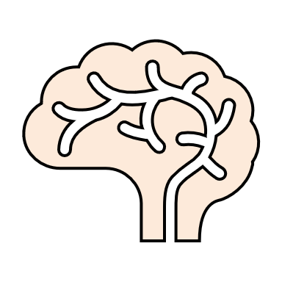
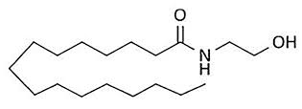

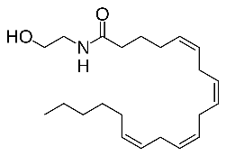
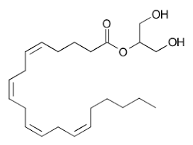


On-going project on endocannabinoids
Optimization of a method for the extraction and quantification of endocannabinoids by means of HPLC-MS/MS and HPLC-HRMS
Method Optimization
Extraction protocol
Chromatograpic conditions
brain tissue, biofluids
PEA, AEA, 2-AG
Optimized Method
cell culture medium
β-caryophyllene
CBD
β-caryophyllene/CBD combination
Essential Oil
Release of PEA, AEA and 2-AG by treated cells in the culture medium

Slide 13
Research collaboration
Prof. Federica Pollastro (UNIUPO)
Prof. Daniele Merli (UNIPV)
Prof. Gianni Sacchetti (UNIFE)
Prof. Laura Mercolini (UNIBO)
Prof. Roccaldo Sardella (UNIPG)
Prof. Coral Barbas (CEU-San Pablo University of Madrid, Spain)
Prof. Fabrizio Manetti (UNISI)
Prof. Caludia Mugnaini (UNISI)
Prof. Lorenzo Corsi (UNIMORE)
Prof. Pietro Andreone (UNIMORE)
Prof. Silvia Alboni (UNIMORE)
Prof. Giovanni Vitale (UNIMORE)
Prof. Nicoletta Galeotti (UNIFI)
Prof. Celestino Santos-Buelga (University of Salamanca, Spain)
Prof. Victor Lopez Ramos (Universidad San Jorge, Zaragoza, Spain)
Prof. Francesco Tamagnini (Reading University, UK)
Extraction and
analysis
In silico study
and synthesis
Biological activity

Slide 14
Number of experimental thesis for CTF: 2
Number of experimental thesis for Pharmacy: 2
federica.pellati@unimore.it
Everything you can imagine, nature has already created
Albert Einstein

